Slide 1
Data Visualization in Python
Data Visualization Concepts
R. Burke Squires
NIAID
Bioinformatics and Computational Biosciences Branch (BCBB)

Slide 2
Get the files…
(http://bioinformatics.niaid.nih.gov)
https://github.com/burkesquires/python_biologist
Download “data_viz_files.zip” in 06_data_viz_python folder
(Click on file, then click on download)
Uncompress
Move to desktop

Slide 3
What is Data Visualization?
“The visual analysis of and communication of data”

Slide 4
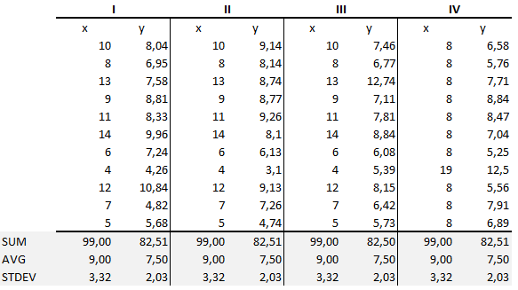
Anscombe’s Quartet
Notes:
http://pbpython.com/visualization-tools-1.html?utm_campaign=Data_Elixir_20&utm_medium=email&utm_source=Data%2BElixir

Slide 5
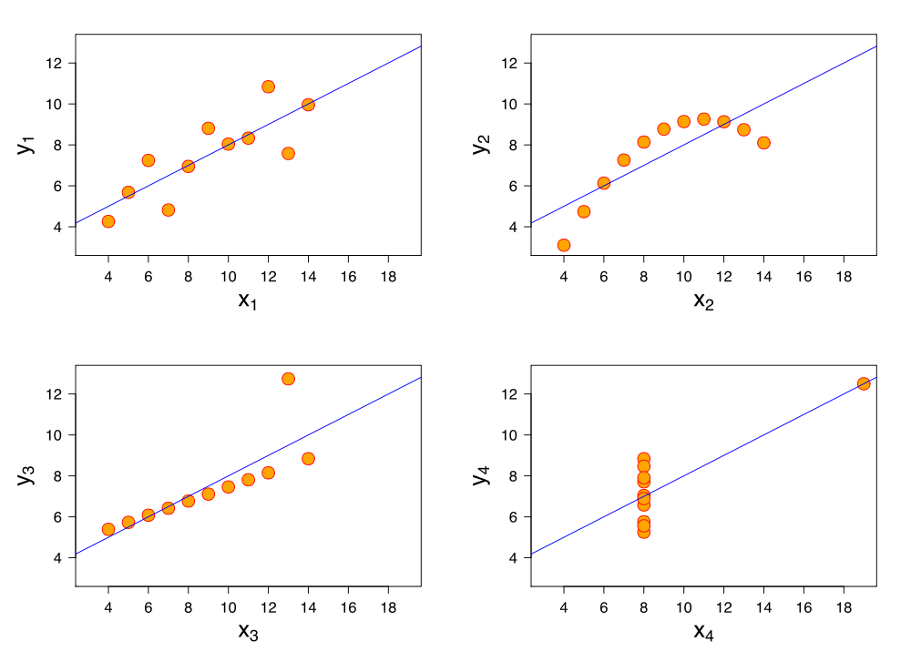
Anscombe’s Quartet
Notes:
Upper-left – randomly distributed
Upper-right – curvilinear linear regression
Lower-left - possible outlier
Lower-right – probable outlier

Slide 6
Objectives
Data Analysis
Understand the data
Derive information from data
Communication
Of information
Of trends
Involves simplification

Slide 7

Napoleon's March by Charles Minard
Minard’s Greatest Hit, c.1869
Notes:
Charles Joseph Minard
Figurative Map of the successive losses in men of the French Army in the Russian campaign 1812-1813.
Drawn by Mr. Minard, Inspector General of Bridges and Roads in retirement. Paris, 20 November 1869. The numbers of men present are represented by the widths of the colored zones in a rate of one millimeter for ten thousand men; these are also written beside the zones. Red designates men moving into Russia, black those on retreat. — The informations used for drawing the map were taken from the works of Messrs. Thiers, de Ségur, de Fezensac, de Chambray and the unpublished diary of Jacob, pharmacist of the Army since 28 October.

Slide 8
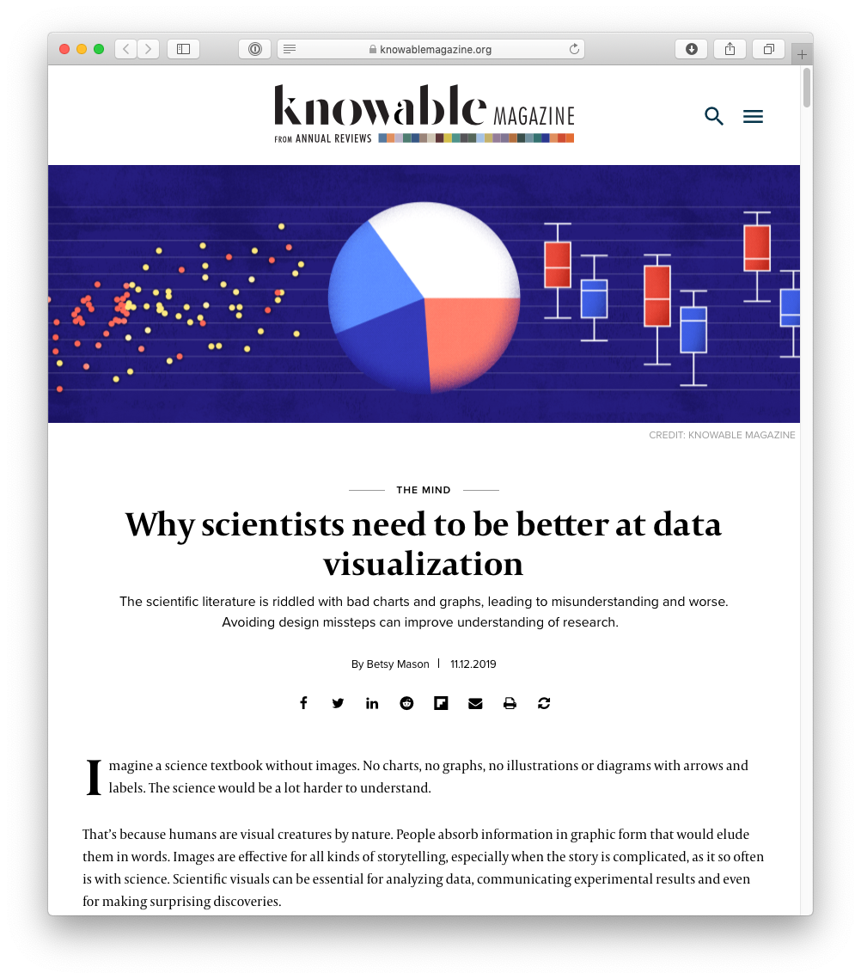
Why scientists need to be better at data visualization
The scientific literature is riddled with bad charts and graphs, leading to misunderstanding and worse. Avoiding design missteps can improve understanding of research.
By Betsy Mason
Knowable Magazine 11.12.2019
https://www.knowablemagazine.org/article/mind/2019/science-data-visualization

Slide 9
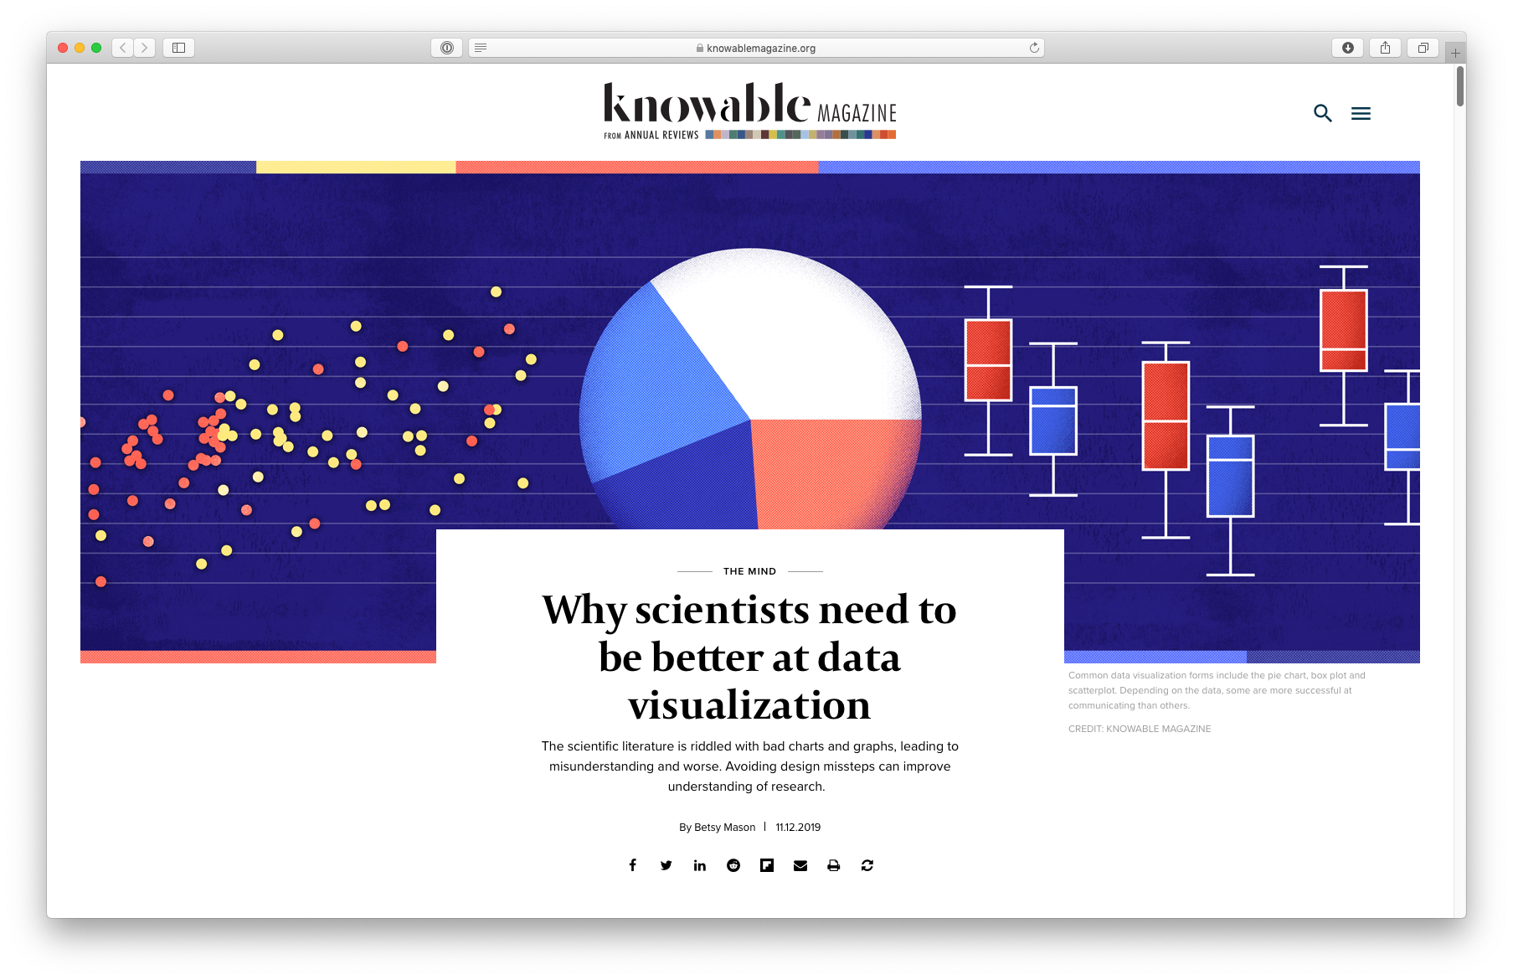
Why scientists need to be better at data visualization

Slide 10
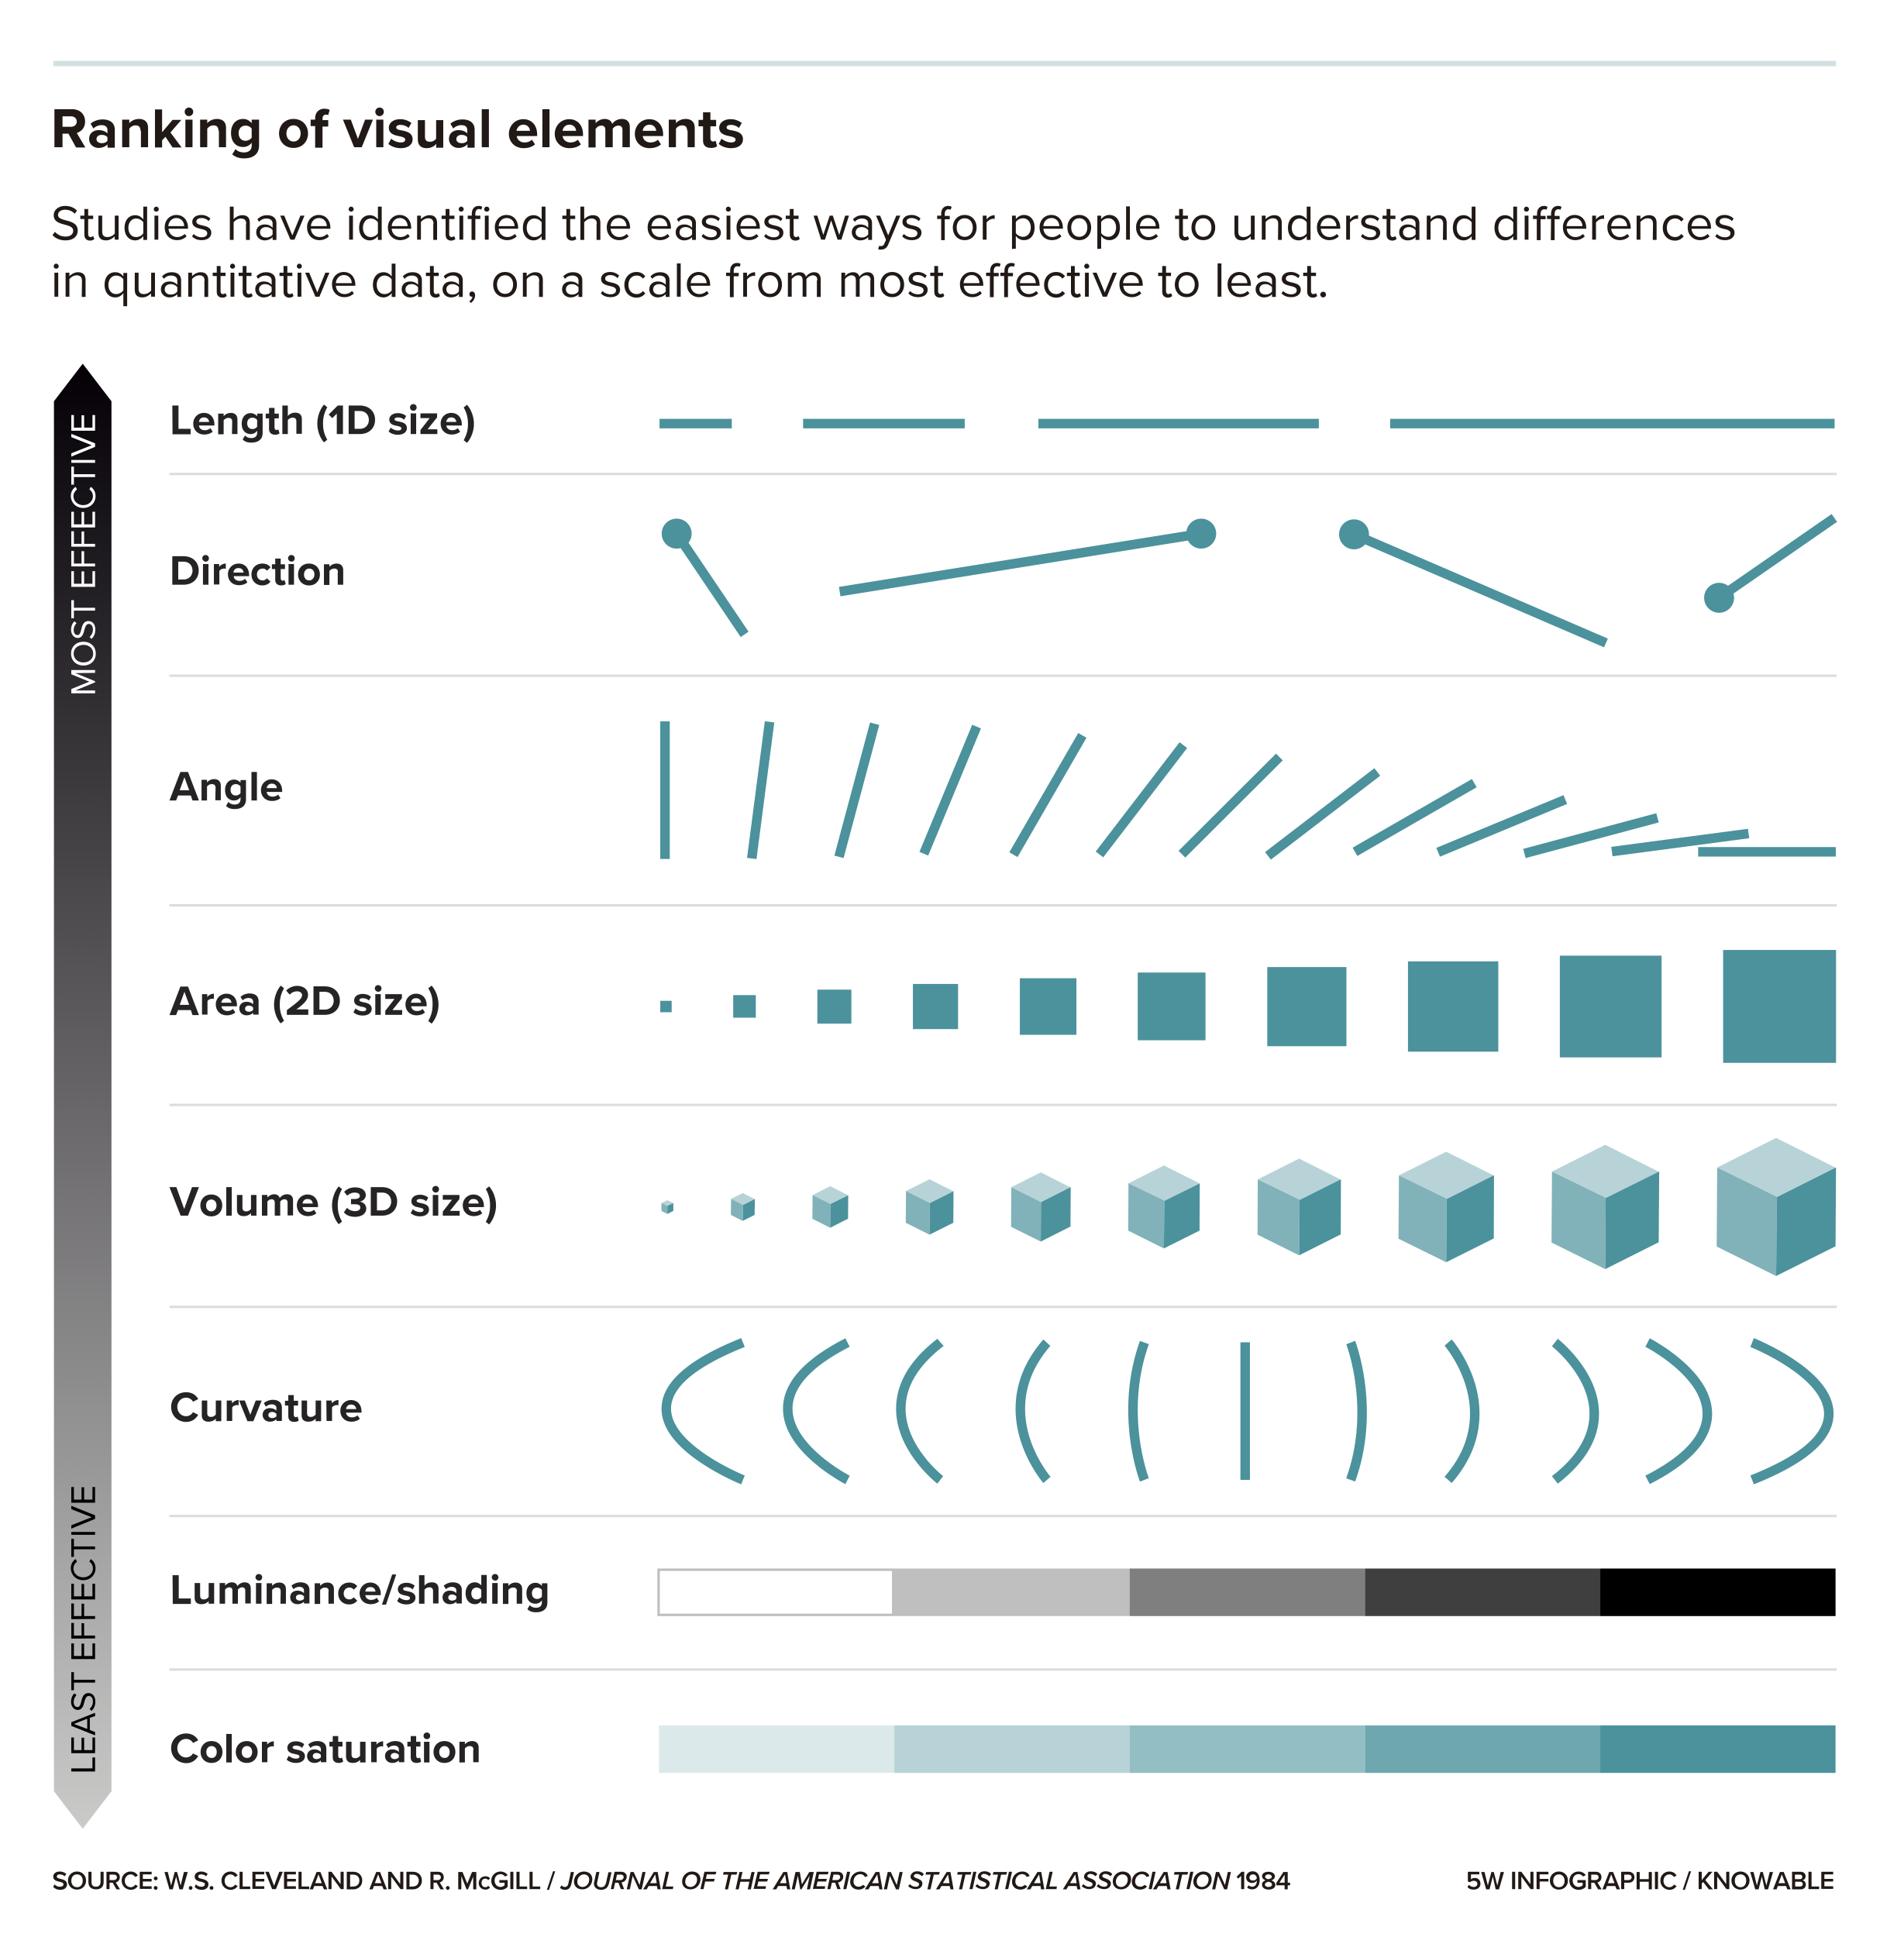
Ranking Visual Elements
People are better at discerning subtleties in some types of visuals than others — the length of two lines, for example, or the direction of a line are easier to tell apart than shades of gray or the intensity of a color. Studies show that graphs using visual elements high on this list are easier to read and more effective than those near the bottom.

Slide 11
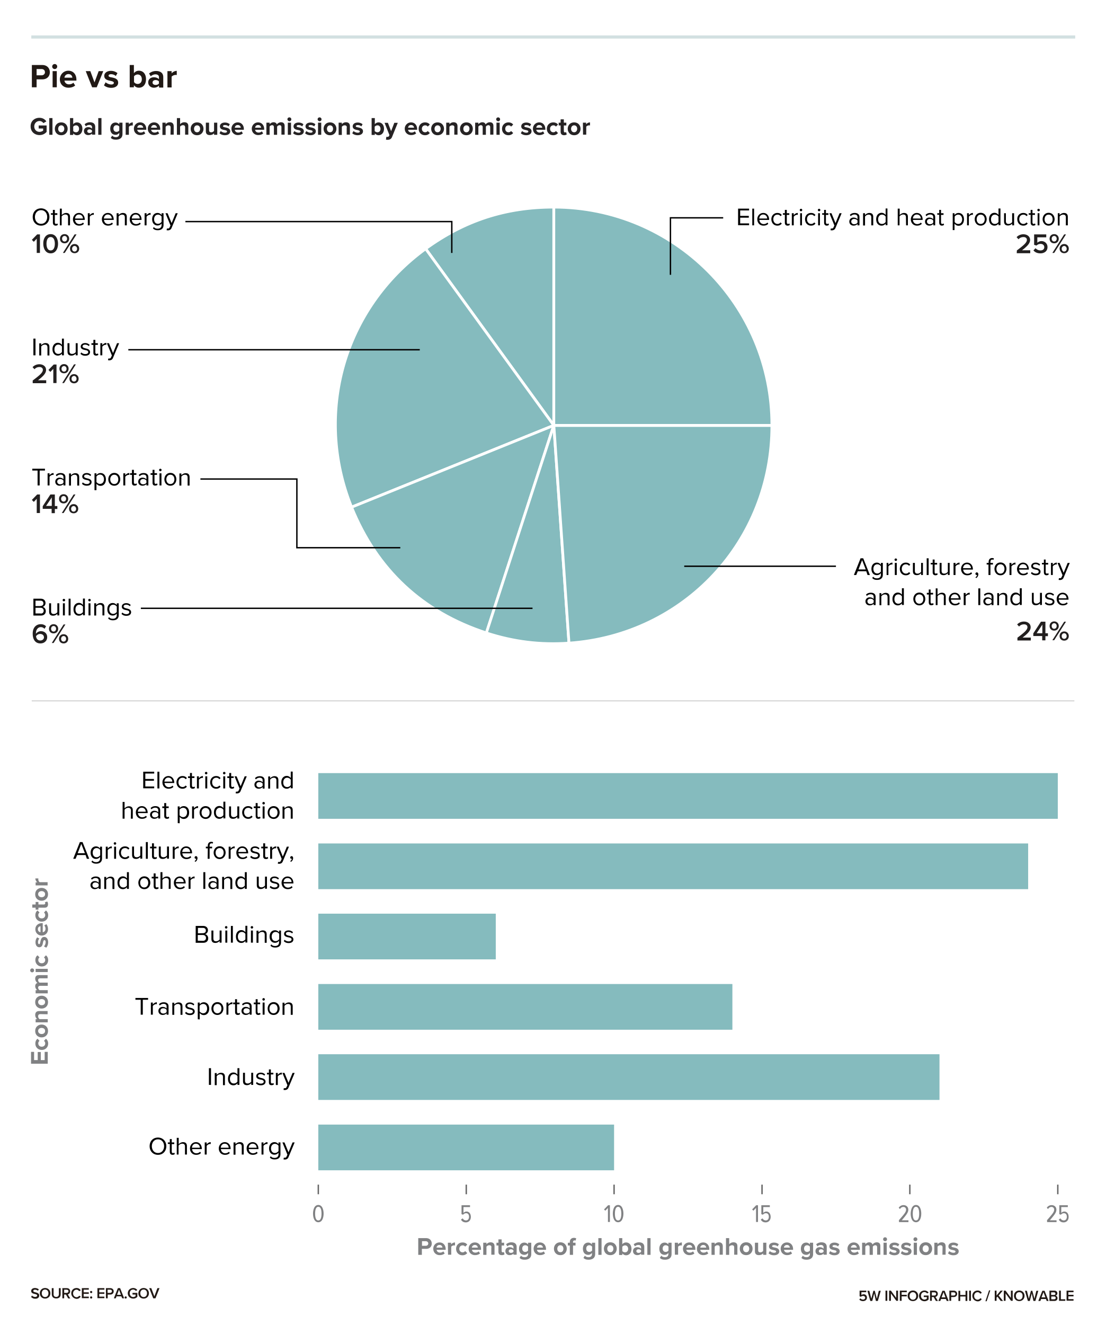
Pie vs Bar Charts
Pie charts are best used to show the relationship of the pieces to the whole. In this graphic, the pie chart effectively shows how big or small each economic sector’s contribution is to total greenhouse gas emissions, but it’s difficult to compare sectors with each other. The bar chart allows for easy comparisons between sectors but doesn’t convey how each one relates to the total.

Slide 12
Ten-ish Simple Rules / Guidelines
Rule 1: Know Your Audience
Rule 2: Identify Your Message
Rule 3: Adapt the Figure to the Support Medium
Rule 4: Captions Are Not Optional
Rule 5: Do Not Trust the Defaults
Rule 6: Use Color Effectively
Rule 7: Do Not Mislead the Reader
Rule 8: Avoid “Chartjunk”
Rule 9: Message Trumps Beauty
Rule 10: Get the Right Tool
http://journals.plos.org/ploscompbiol/article?id=10.1371/journal.pcbi.1003833

Slide 13
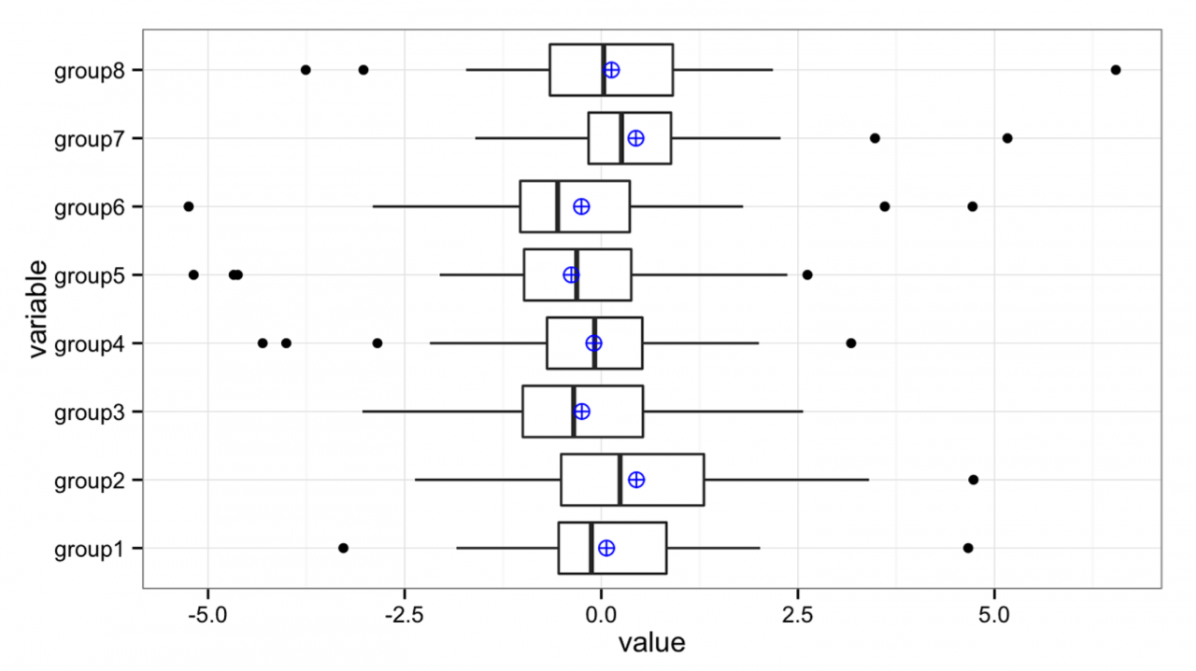
Ten-ish Simple Rules / Guidelines
Know your audience
http://journals.plos.org/ploscompbiol/article?id=10.1371/journal.pcbi.1003833

Slide 14

Ten-ish Simple Rules / Guidelines
Identify your message
http://upload.wikimedia.org/wikipedia/commons/9/9b/Social_Network_Analysis_Visualization.png

Slide 15
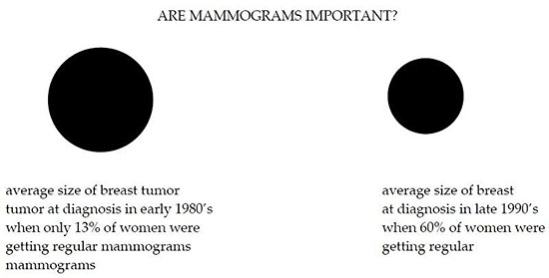
Ten-ish Simple Rules / Guidelines
Captions are not optional
http://ksrowell.com/blog-visualizing-data/2010/12/23/data-visualization-double-take/

Slide 16
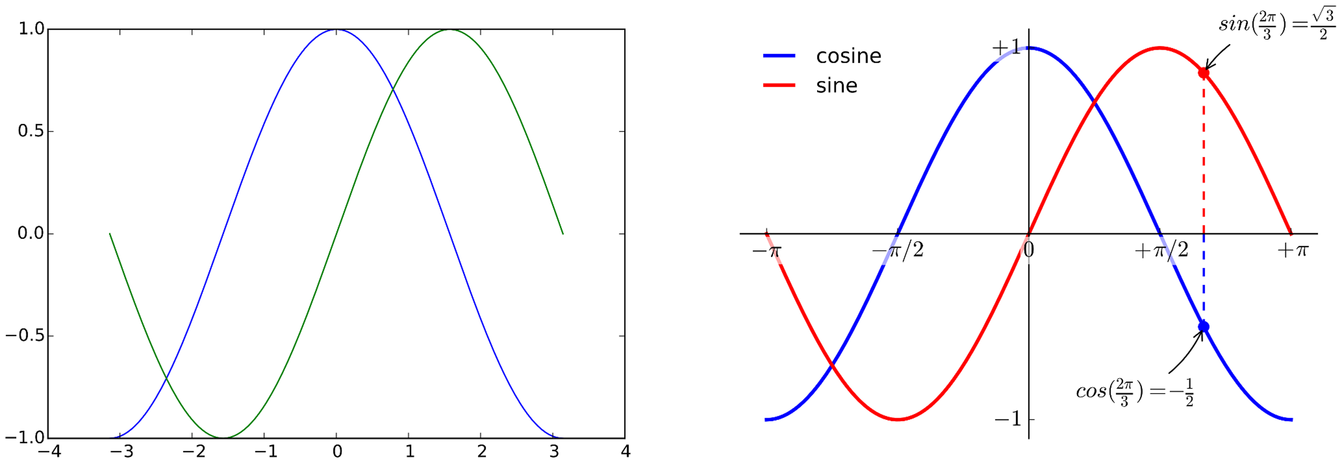
Ten-ish Simple Rules / Guidelines
Do not use the defaults
http://journals.plos.org/ploscompbiol/article?id=10.1371/journal.pcbi.1003833

Slide 17
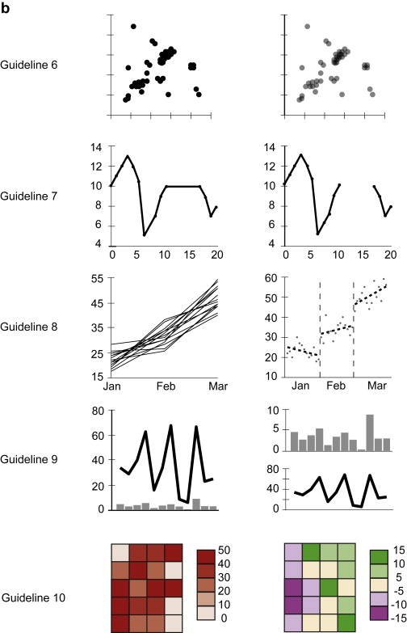
Ten-ish Simple Rules / Guidelines
Use color effectively
http://journals.plos.org/ploscompbiol/article?id=10.1371/journal.pcbi.1003833

Slide 18
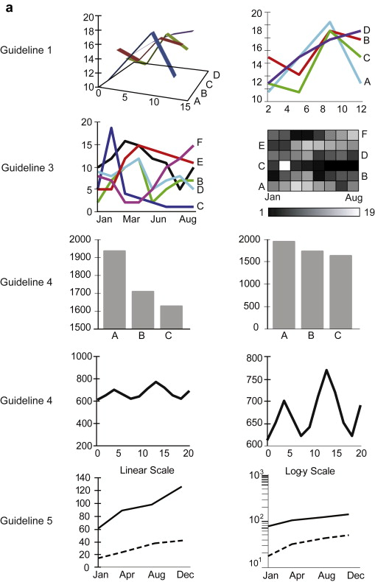
Ten-ish Simple Rules / Guidelines
Do not mislead the reader
http://journals.plos.org/ploscompbiol/article?id=10.1371/journal.pcbi.1003833

Slide 19
Ten-ish Simple Rules / Guidelines
Create the simplest graph
http://journals.plos.org/ploscompbiol/article?id=10.1371/journal.pcbi.1003833

Slide 20
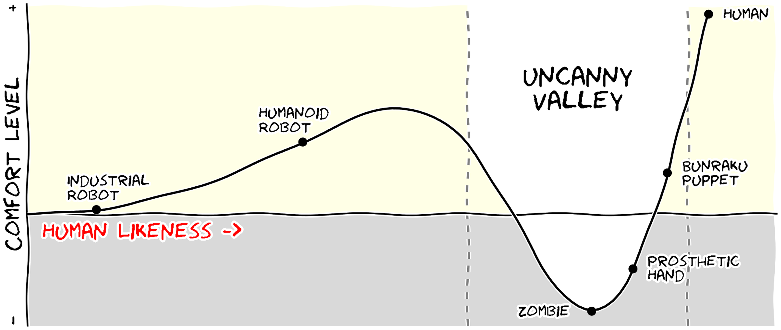
Ten-ish Simple Rules / Guidelines
Message trumps beauty
http://journals.plos.org/ploscompbiol/article?id=10.1371/journal.pcbi.1003833

Slide 21
Ten-ish Simple Rules / Guidelines
Get the right tool…
http://journals.plos.org/ploscompbiol/article?id=10.1371/journal.pcbi.1003833

Slide 22
How Much Data Can You Put In A Chart?

Slide 23
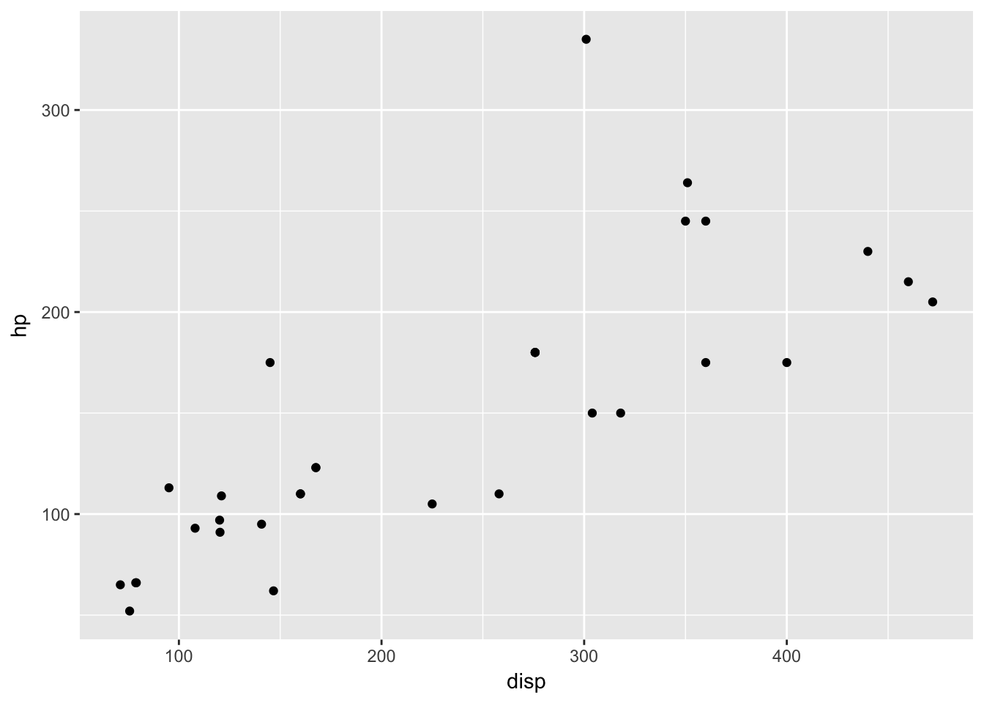
How Much Data Can You Present In A Single Graph? Two Dimensions?
Source: Sean Davis, NCI - https://github.com/seandavi/hour_of_code; NOTE: These are “R” visualizations

Slide 24
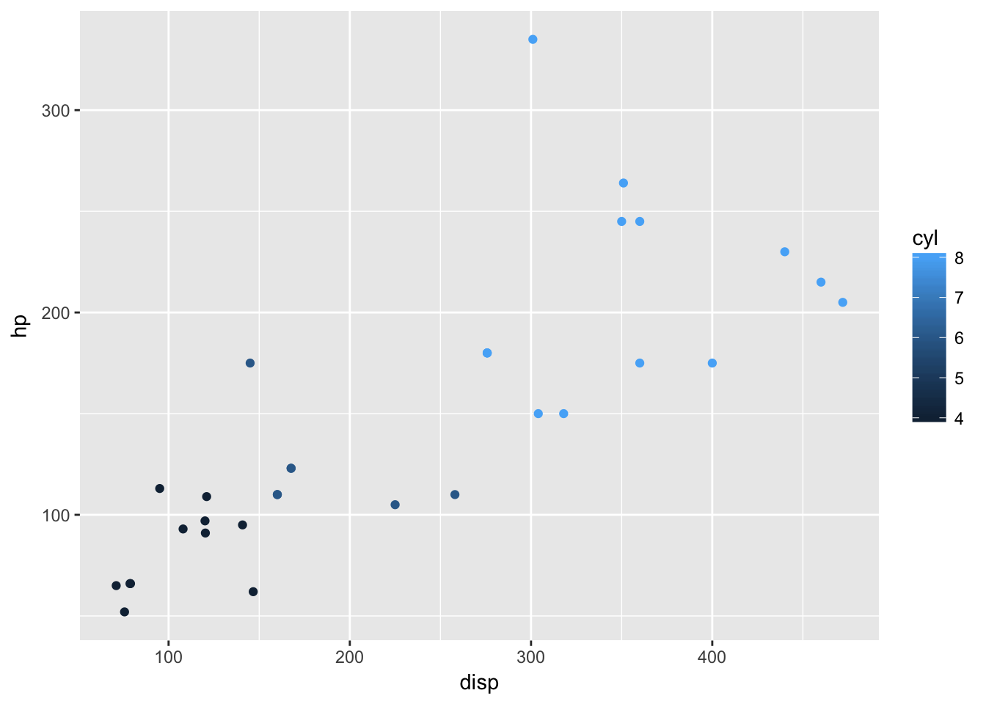
How Much Data Can You Present In A Single Graph? Three Dimensions?

Slide 25
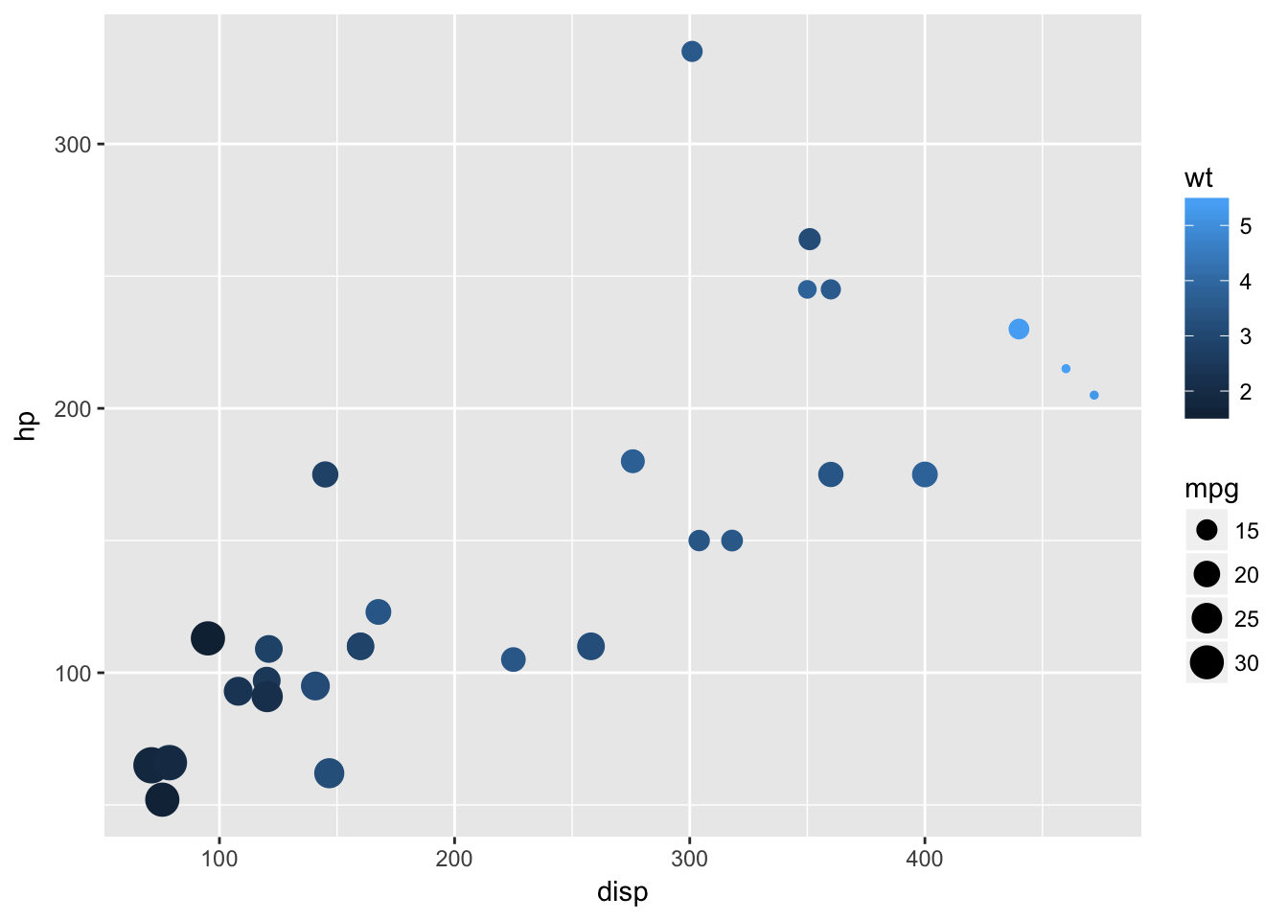
How Much Data Can You Present In A Single Graph? Four Dimensions?

Slide 26
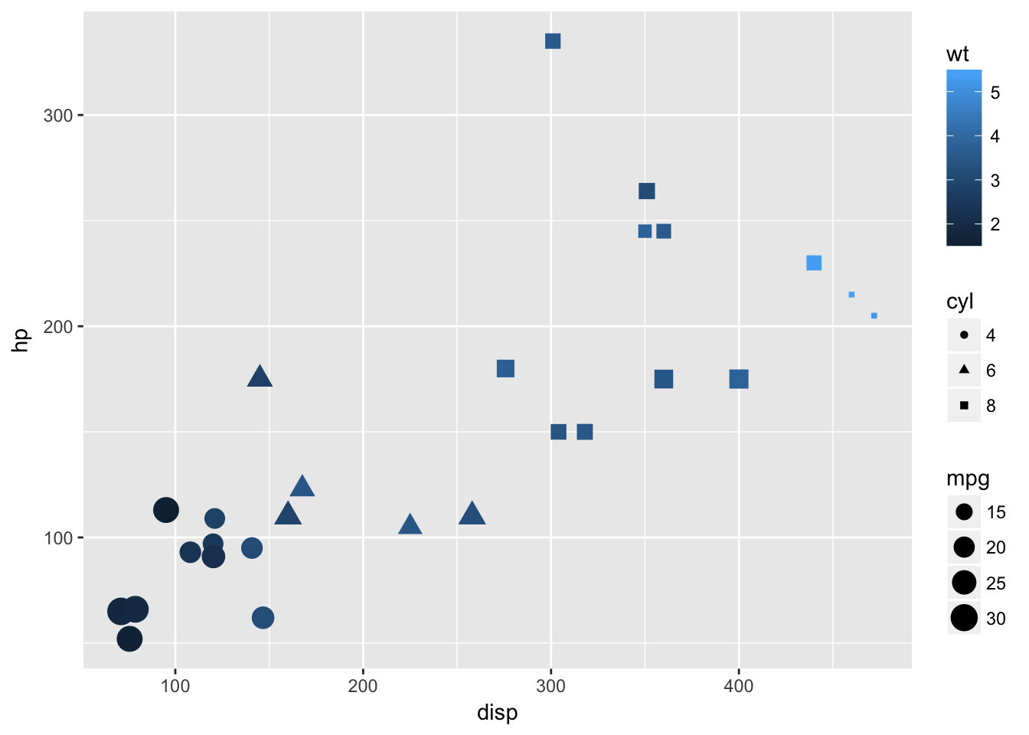
How Much Data Can You Present In A Single Graph? Five Dimensions?

Slide 27
How Do I Know Which Chart To Use?

Slide 28
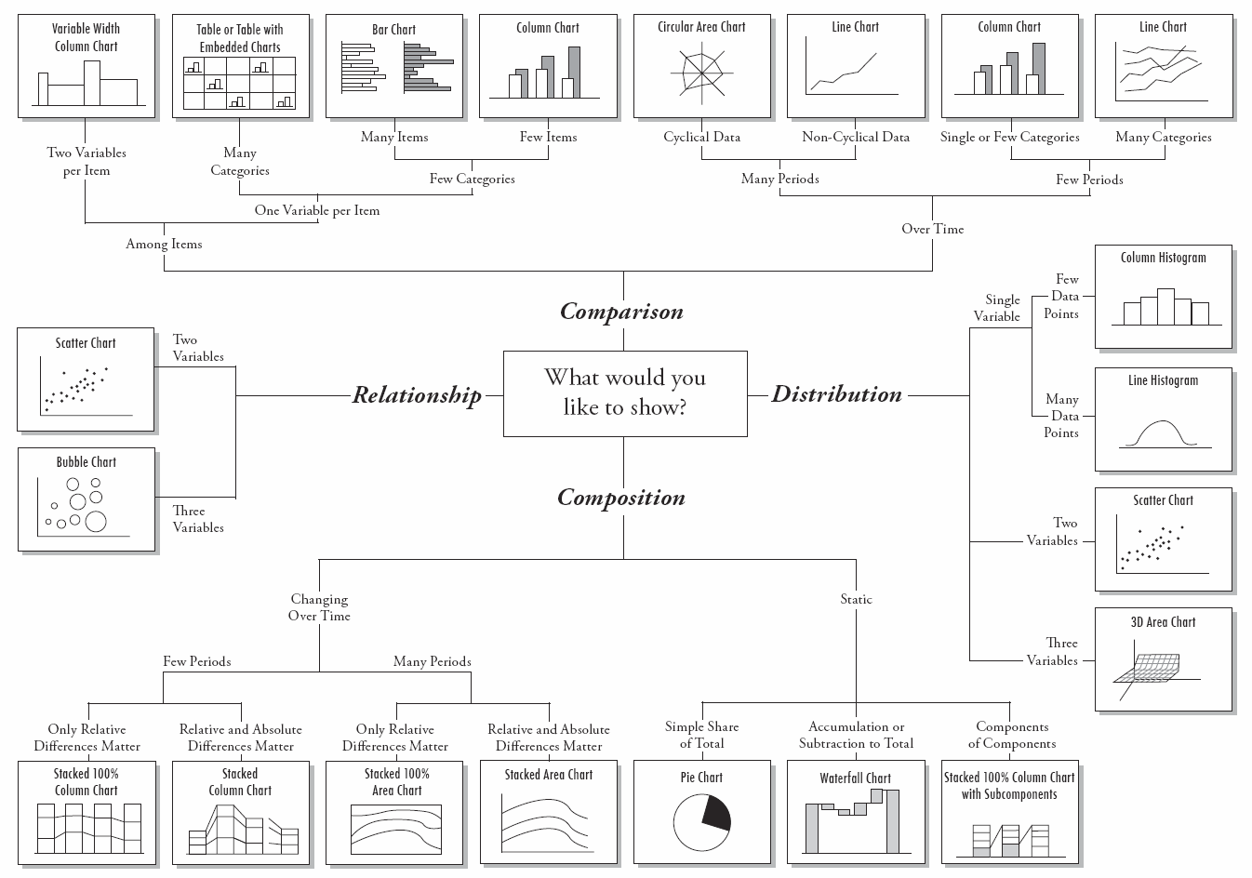
Choose the Right Chart Type for your Data
Source: http://img.labnol.org/di/choosing_a_good_chart2.pdf

Slide 29
Data Visualization
Static data visualization
matplotlib, seaborn, ggpy (ggplot)
Dynamic visualization
Bokeh
Declarative Visualization
Altair
Specialized visualizations
Mapping of geographical data, timelines
3D visualization – Vispy
Notes:
https://speakerdeck.com/wrobstory/python-data-visualization-what-now
Check out
http://newcoder.io/Intro-DataViz/
http://radar.oreilly.com/2013/03/python-data-tools-just-keep-getting-better.html
Network visualization (Cytoscape, Gelphi)

Slide 30
Additional (non-python) Data Visualization Techniques:

Slide 31
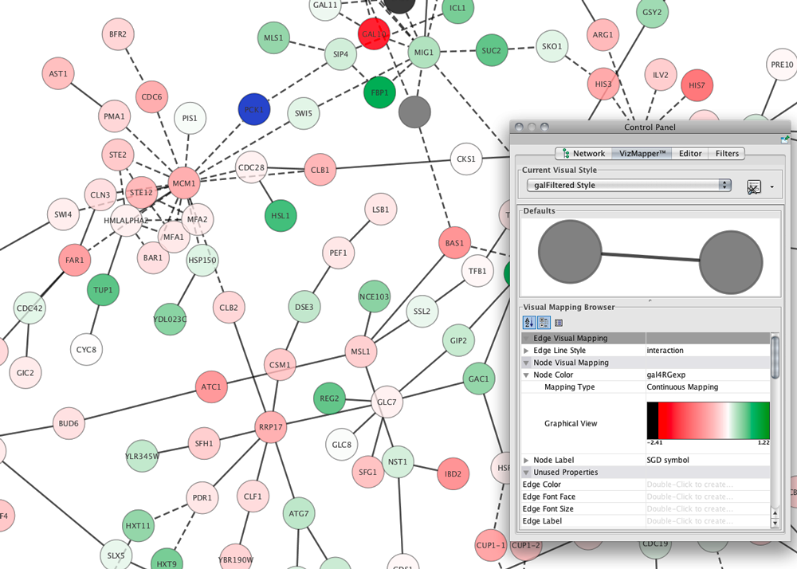
Network Visualization: Cytoscape

Slide 32
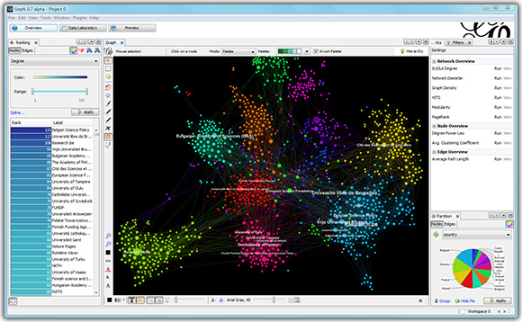
Network Visualization: Gelphi

Slide 33
References
Ten Simple Rules for Better Figures. Nicolas P. Rougier , Michael Droettboom, Philip E. Bourne. PLOS Computational Biology. September 11, 2014

Slide 34
Resources
one-dataset-visualized-25-ways
http://flowingdata.com/2017/01/24/one-dataset-visualized-25-ways/

Slide 35
Resources
Nature Methods: Point of View column
http://blogs.nature.com/methagora/2013/07/data-visualization-points-of-view.html
http://mkweb.bcgsc.ca/pointsofview/
Publications
https://www.knowablemagazine.org/article/mind/2019/science-data-visualization
https://www.annualreviews.org/doi/pdf/10.1146/annurev-biodatasci-080917-013424
http://www.vanseodesign.com/web-design/gestalt-principles-of-perception/
Course
http://enrico.bertini.io/teaching/
Chart Chooser
http://labs.juiceanalytics.com/chartchooser/

